Slide 1
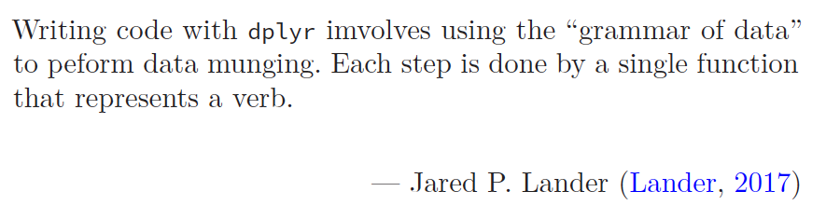
Exploring Operations Research with R: A Workshop
04 – dplyr
https://github.com/JimDuggan/Exploring-OR-with-R-Workshop

Slide 2
Topics Overview
Topic | Description | ~Timing
1 | Introduction to R and Posit Cloud | 10 mins
2 | Storing data using data frames / tibbles | 10 mins
3 | Visualisation with ggplot2 | 20 mins
4 | Data transformation with dplyr | 20 mins
5 | Using R with OR – Four Examples | 30 mins

Slide 3
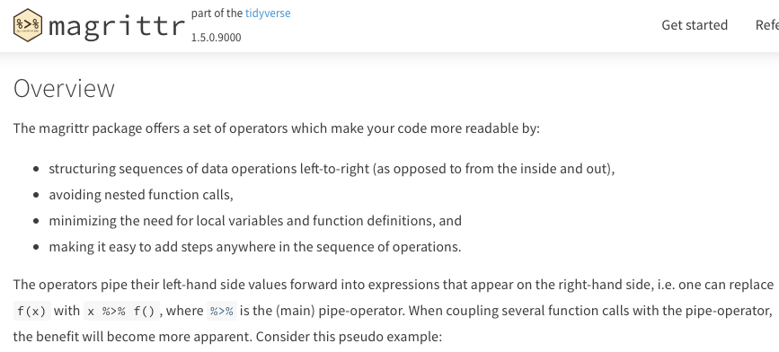
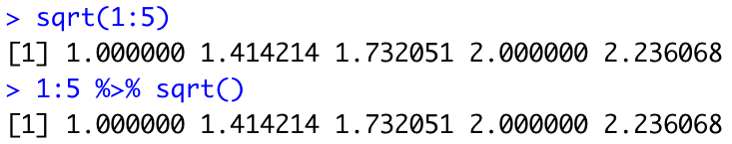
Combining operations with the Pipe
The pipe %>% comes from the magrittr package (Stefan Milton Bache)
Helps to write code that is easier to read and understand
x %>% f(y) turns into f(x, y)
x %>% f(y) %>% g(z) turns into g(f(x, y),z)
https://magrittr.tidyverse.org

Slide 4
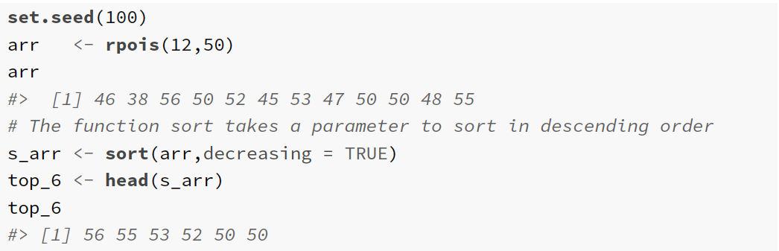
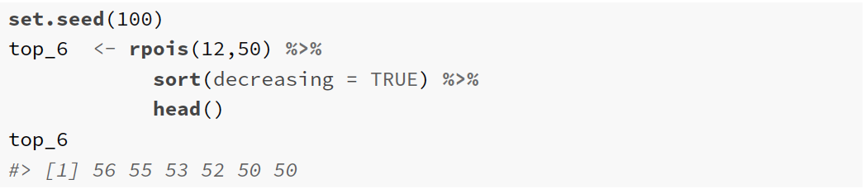

Slide 5
Need for dplyr
Visualisation is an important tool for insight generation, but it’s rare that you get the data in exactly the right form you need (Wickham and Grolemund 2017)
Create new variables
Create summaries
Order data
dplyr package is designed for data transformation

Slide 6
dplyr Basics: 5 key functions
Function | Purpose
filter() | Pick observations by their values
arrange() | Reorder the rows
select() | Pick variables by their names
mutate() | Create new variables with functions of existing variables
summarise() | Collapse many values down to a single summary
”A grammar of data manipulation”
All verbs (functions) work similarly
The first argument is a data frame/tibble
The subsequent arguments decide what to do with the data frame/tibble
The result (data frame/tibble) supports chaining of steps – NOTE the “pipe operator” which we will cover later.
https://dplyr.tidyverse.org

Slide 7
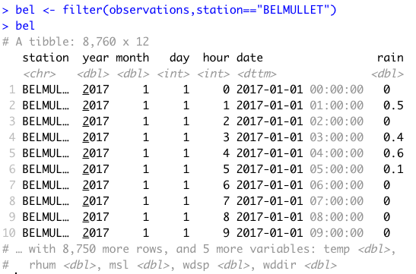
1. filter() aimsir17 tibble observations
First argument the name of the data frame
Subsequent arguments are expressions that filter the data frame
Subsequent arguments can be viewed as a succession of “and” statements
Number of columns does not change
Number of rows reduced (filtered)

Slide 8
Relational operators in R
Operators | Description
< | less than
<= | less than or equal to
> | greater than
>= | greater than or equal to
== | exactly equal to
!= | not equal to
!x | not x
x | y | x OR y
x & y | x AND y

Slide 9
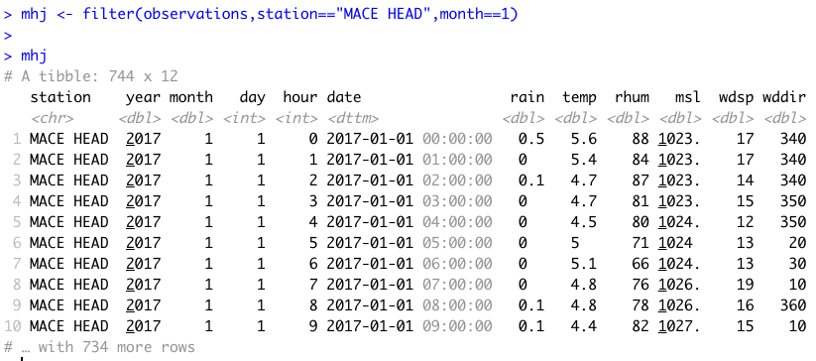
Show rows for “MACE HEAD” in January

Slide 10
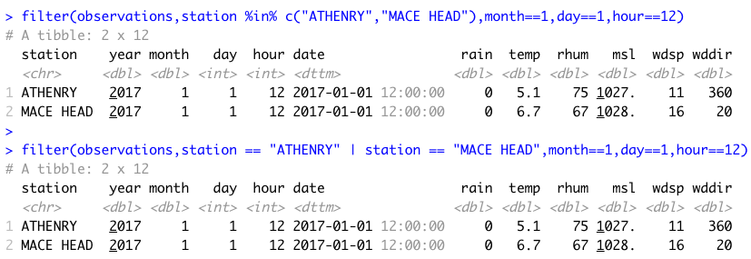
Useful approaches for filtering more than one value
%in% operator in R

Slide 11
Challenge 5.1
Show the weather for “ROCHES POINT” on October 16th at 12 midday. This should return just one observation.

Slide 12
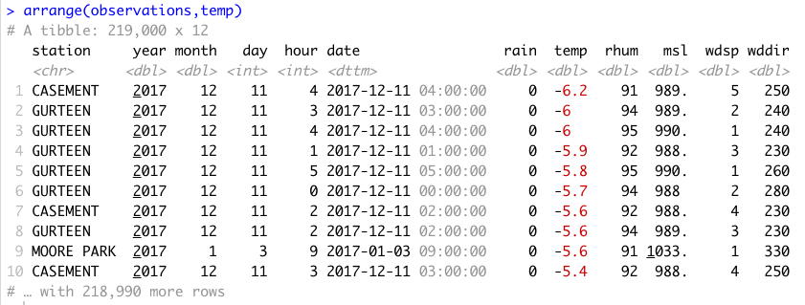
2. arrange()
Changes the order of rows.
Used for sorting values
Takes a tibble and a set of column names to order by

Slide 13
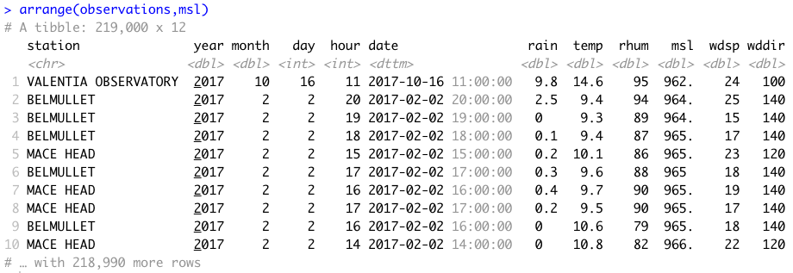
Mean Sea Level Pressure

Slide 14
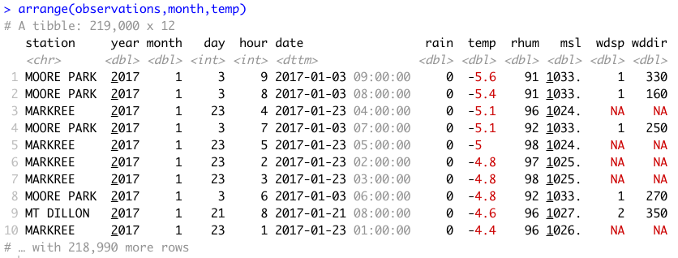
More than one value

Slide 15
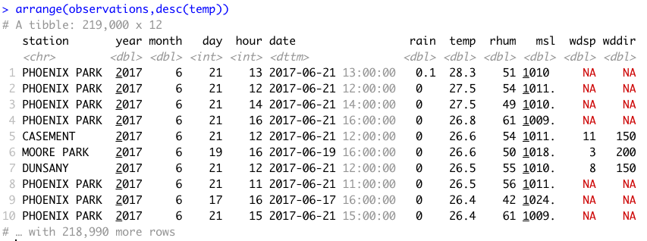
In descending order - desc()

Slide 16
Challenge 5.2
Arrange the observations by month and by highest temperature

Slide 17
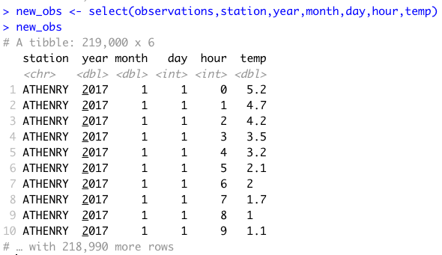
3. select()
It is not uncommon to get datasets with hundreds, or even thousands, of variables
A challenge is to narrow down on the variables of you’re interested in
select() allows you to rapidly zoom in on a useful subset using operations based on the variable names
Number of rows does not change

Slide 18
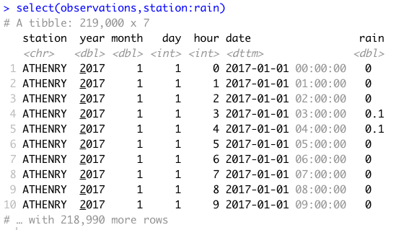
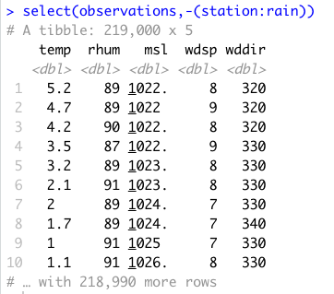
Useful options with select()

Slide 19
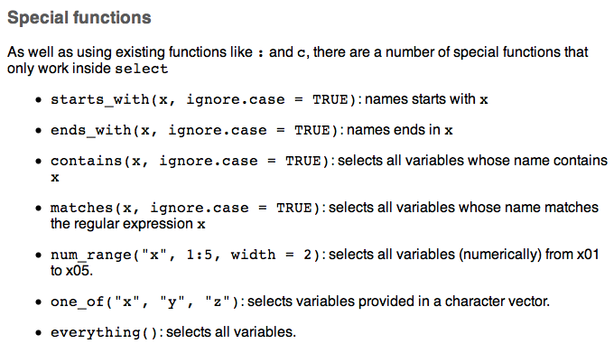
Special functions with select()

Slide 20
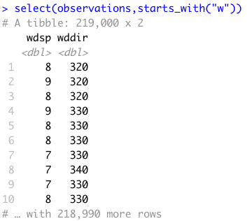
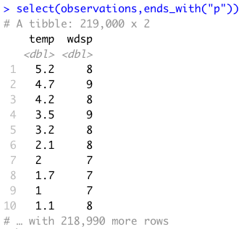
Examples

Slide 21
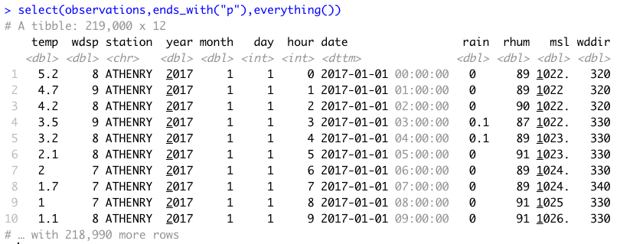
everything()

Slide 22
4. mutate()
It is often useful to add new columns that are functions of existing columns
mutate() always adds new columns at the end of your data set.
For example, convert the mph wind speed in observations to a new column, kph.
Use a simplified observations tibble with day, month, station, wdsp as columns, and for “ROCHES POINT” on October 16th
Assume 1 mi = 1.609344 km

Slide 23
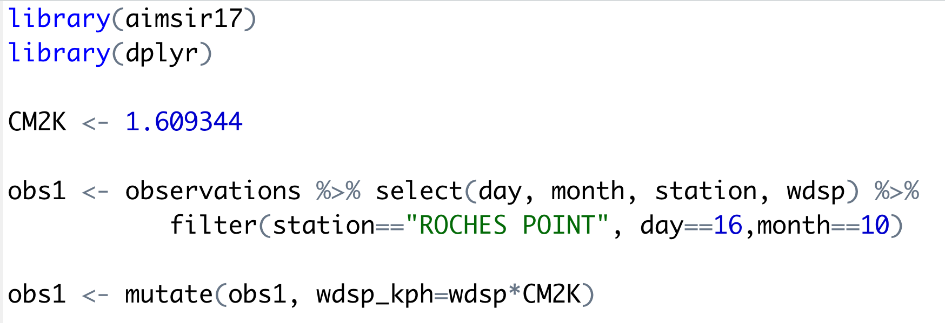
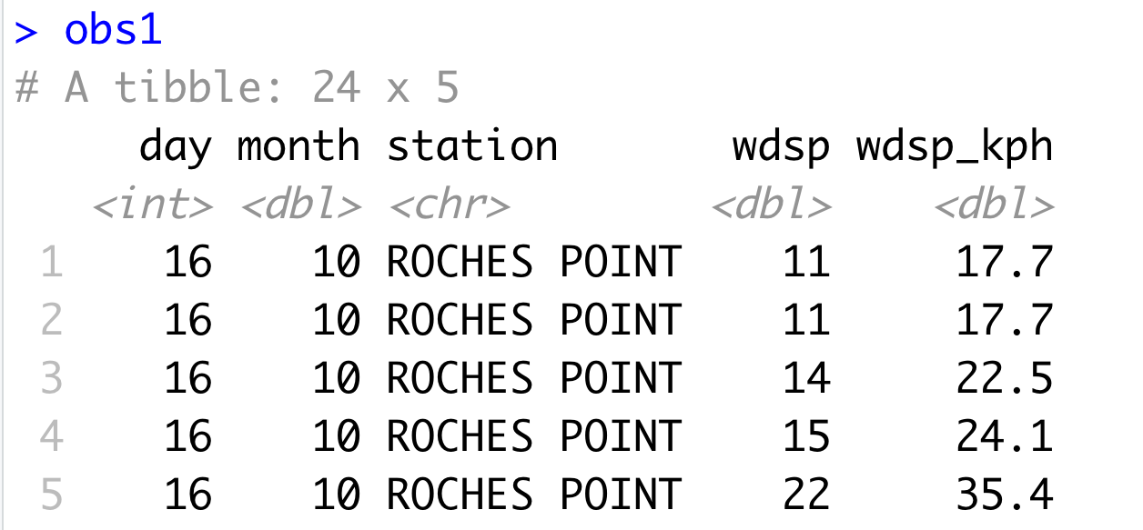
Example of mutate

Slide 24
Useful Creation Functions
There are many functions for creating new variables that can be used with mutate()
The key property is that the function must be vectorised:
It must take a vector of values as input, and,
Return a vector with the same number of values as output

Slide 25
Challenge
Add a new column rain_in, which measures the hourly rainfall in inches
Assume a conversion constant of 1 mm = 0.0393701 inches

Slide 26
5. summarise()
The last key verb is summarise()
It collapses a data frame into a single row
Not very useful unless paired with group_by() (it will just perform a summary of the whole data set)
Very useful to combine with the pipe operator

Slide 27
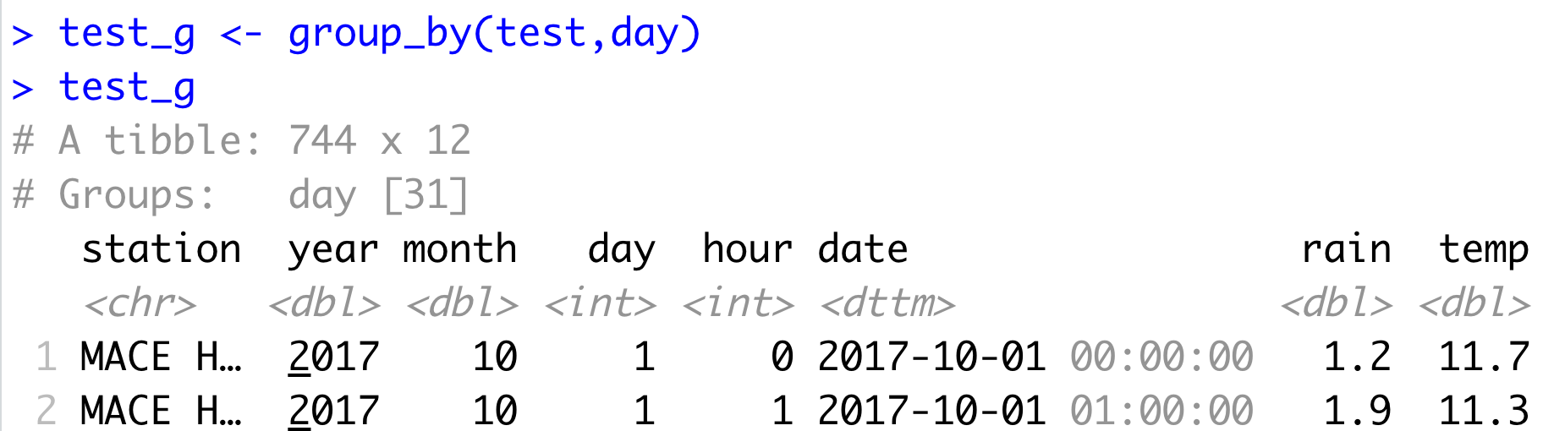
group_by()
Most data operations are useful done on groups defined by variables in the the dataset.
The group_by function takes an existing tbl and converts it into a grouped tbl where operations are performed "by group”.

Slide 28
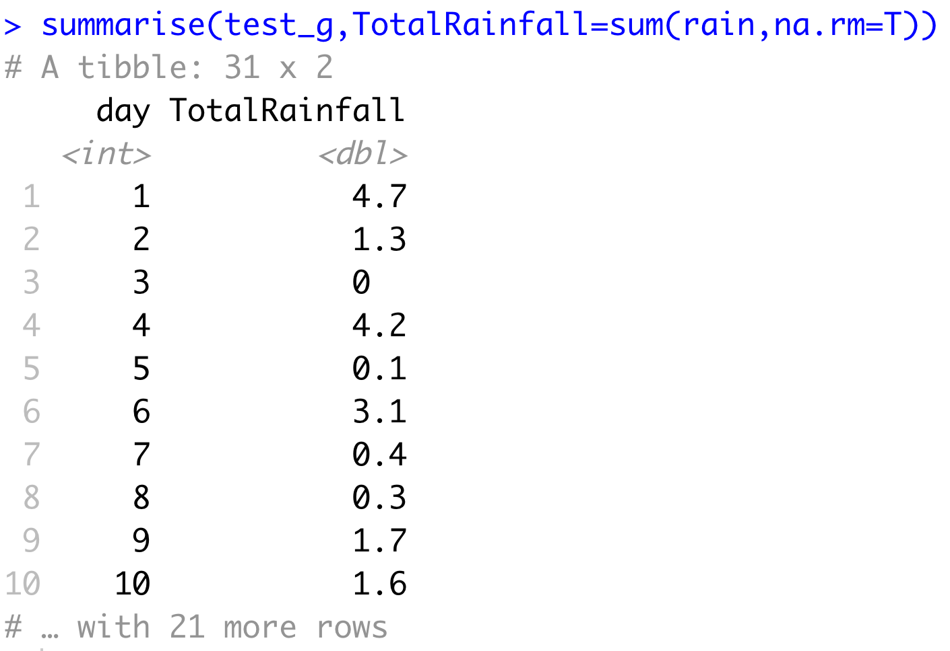
Key idea
This grouping can then be exploited by summarise

Slide 29
Overall idea…
Original data frame
Grouped data frame
group_by()
summarise()

Slide 30
Useful Summary Functions
Grouping | Examples
Measures of location | mean(), median()
Measures of spread | sd(), IQR(),mad()
Measures of rank | min((), quantile(), max()
Measures of position | first(), nth(), last()
Counts | n(), n_distinct()
Counts and proportions of logical values | sum(x>0) when used with numeric functions, (T,F) converted to (1,0)

Slide 31
Challenge
For “BELMULLET” calculate the total daily rainfall for October, and show using ggplot.

Slide 32
dplyr Summary: 5 key functions
Function | Purpose
filter() | Pick observations by their values
arrange() | Reorder the rows
select() | Pick variables by their names
mutate() | Create new variables with functions of existing variables
summarise() | Collapse many values down to a single summary
”A grammar of data manipulation”
All verbs (functions) work similarly
The first argument is a data frame/tibble
The subsequent arguments decide what to do with the data frame/tibble
The result (data frame/tibble) supports chaining of steps – NOTE the “pipe operator” which we will cover later.
https://dplyr.tidyverse.org

